Slide 1
Marketing Analytics – Customer Segmentation and Optimizing Campaign Spends

Slide 2
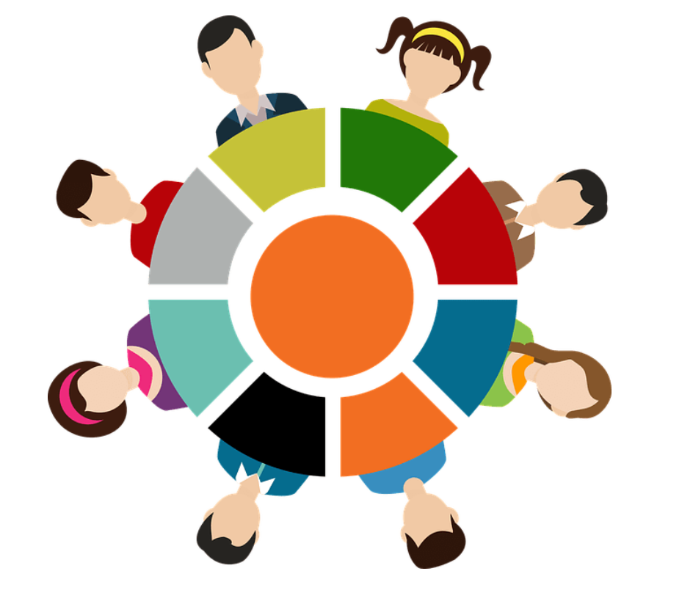
Customer Segmentation – A Data-Based Approach
Data has become a financial institution’s most valuable asset and Customer Segmentation plays a vital role in all of this – to understand customer’s needs and preferences and how to better target those needs and preferences in order to increase revenue
But on it’s own, customer segmentation isn’t enough – it needs to be effective
Notes:
Image Link: https://medium.com/@reubenyonatan/understanding-and-implementing-behavioral-segmentation-in-the-customer-journey-b90ccd06bd7a
Notes:
Customer segmentation: You’ve heard of it, you’re familiar with it, and you probably already use some form of it within your organization. In the digital age, data has become financial institution’s most valuable asset, providing insight into product performance, consumer behavior, market trends, and more. Customer segmentation plays a vital role in all of this, creating opportunities to better understand each customer’s needs and preferences and how to better target those needs and preferences in order to increase revenue.
But customer segmentation, taken on its own, isn’t enough. In order to see tangible results from your commercial or retail banking customer segmentation strategy, it needs to be effective.

Slide 3
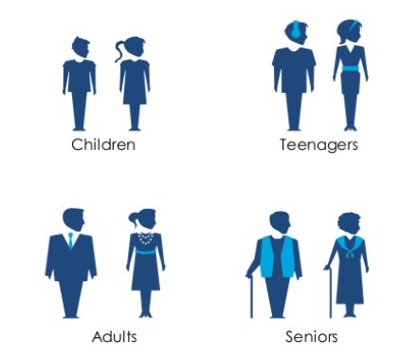
Customer Segmentation – A Data-Based Approach
Customers leave behind a large footprint in terms of the transactions they perform, which can be analyzed to determine who the most valuable customers are and how to nurture and grow the business by leveraging the existing customer base
Most banks follow the basic approach of viewing the customer base by basic demographics – age, geography, income, etc. – but that will only take you so far
Notes:
Image Link: https://www.slideshare.net/infoDiagram/visualizing-customer-segments

Slide 4
Customer Segmentation – A Data-Based Approach
The basic approach to customer segmentation in banking is limited because it lacks granularity and nuance; it relies on basic assumptions and treats each demographic as a homogenized group, when it’s anything but
The problem with this approach is that the data don’t show you anything that you don’t already know
To take it a step further – you need to start viewing segmentation as a data-driven process and work to understand customers as individuals – for example: Why does a certain customer have home loans with competitors, what are the reasons?
Notes:
Notes:
This approach to customer segmentation in banking is limited because it lacks granularity and nuance; it relies on basic assumptions and treats each demographic as a homogenized group, when it’s anything but.
Basic segmentation is a good entry customer segmentation strategy, but you need to take things a step further and work to understand your customers as individuals. It’s a challenge almost every financial institution faces, regardless of whether it specializes in consumer, commercial, or retail banking.
Even organizations that excel at collecting really granular consumer data fail to leverage it as successfully as they could. For example, to return to the home loan example, let’s say that you go into your customer relationship management system and segment to see which customers have home loans with competitors. You then develop a marketing campaign to target these customers based on that information. Seems like a winning strategy, doesn’t it?
Not exactly. Your marketing campaign might convince a few customers to switch to your home loan product, which is a net positive — but your customer segmentation strategy would be even more effective if it indicated why those customers chose to work with other institutions in the first place. It could be for any number of reasons related to competitive products, relationship, or perhaps a lack of awareness of the products and services offered by your institution. Until you address the root cause, your customer segmentation strategy will continue to come up short.

Slide 5

Customer Segmentation – A Data-Based Approach
Applying analytics to complex data helps you uncover hidden patterns that are not obvious, like which customer segments tend to get loans and who is a suitable candidate for investment products
But the biggest challenge comes from interpreting the data-generated segments – and making strategic decisions may vary based on the profiles of these segments
Notes:
Image Link: https://www.vecteezy.com/vector-art/628211-decision-making-concept-with-character-creative-flat-design-for-web-banner
Notes:
As you can see, it’s relatively easy to build profiles based on customer information and make strategic decisions to target each of these segments. Bear in mind that the nature of these profiles will vary depending on what type of banking you do — for example, in commercial banking, you’ll likely want to consider which industry or sector your customers work in.

Slide 6
Customer Segmentation – A Data-Based Approach
Questions that may arise post-segmentation could be:
How can I turn the outcomes of my clustering algorithm into usable business segments?
How can I match data clusters to business labels like savers, investors and loan-takers?
How many segments can I match in a statistically or commercially valid manner?
Is it enough to create an effective behavioural segmentation?
Notes:
Image Link:
Notes:
the biggest challenge comes at the moment you want to interpret your data-generated results.
New questions arise such as:
How can I turn the outcomes of my clustering algorithm into usable business segments?
How can I match data clusters to business labels like savers, investors and loan-takers?
How many segments can I match in a statistically or commercially valid manner?
Is it enough to create an effective behavioural segmentation?
The answers to all these questions lie in your ability to measure the effectiveness of customer segmentation analysis from a strictly business-success point of view. Does your solution bring more value than it costs?

Slide 7

Customer Segmentation – A Data-Based Approach
On applying data-driven segmentation, opportunities arise to further analyse the behavioural profiles of your customers using complex analytical techniques – for example, analytics allows to set the timing of cross-selling campaigns by predicting events in your customers’ life cycle and improve risk scoring by taking probable future behaviour into account, tailor recommendations for each segments by diving further into customer data, etc.,
Notes:
Image Link: https://www.vecteezy.com/vector-art/2007051-concept-of-data-analysis-for-website-and-mobile-website-data-analytics-for-company-marketing-solutions-or-financial-performance-budget-accounting-or-statistics-concept-flat-design-illustration
Notes:
Once you have successfully applied data-driven segmentation, the doors are open to even more complex techniques – you can discover new ways to get even deeper insights into your client base. This approach brings you real predictive power. You can use it to analyse the behavioural profiles of your customers. It allows you to accurately set the timing of cross-selling campaigns by predicting events in your customers’ life cycle and improve risk scoring by taking probable future behaviour into account.

Slide 8
Customer Segmentation – Benefits
Establish one master version for each customer
Effective ad campaigns tailored to each segments
Achieve smarter cross sell and up sell of products
Real time monitoring and reallocation of segments based on customer movements
Profile new customers as soon as they sign up
Predict next best action for each customer

Slide 9
Python Case Study – Customer Segmentation
Objective:
Identify different segments among the existing customer base, as per their spending patterns as well as past interactions with the bank.
Dataset:
https://www.kaggle.com/arjunbhasin2013/ccdata
Credits availed by various customers of a bank, and their usage of the same has been detailed out in the dataset. Various transactions undertaken and credit repayment information are also provided for comprehensive analysis and segmentation of customers.

Slide 10
Python Case Study – Customer Segmentation
Data Preprocessing:
Missing value imputation – identify and fix missing values
Outlier detection and treatment – identify and treat extreme values (outliers)
Feature scaling – scaling numerical features to reduce skewness

Slide 11
Python Case Study – Customer Segmentation
Machine Learning algorithms:
Scaled data is fit with KMeans clustering model for a range of clusters
The elbow method is first used to find the optimal number of clusters at which SSE begins to decrease linearly
Silhouette scores are also used to identify optimal number of clusters by choosing those with a high score
Reverse scaling of data is carried out to restore the original unscaled values

Slide 12
Python Case Study – Customer Segmentation
Machine Learning algorithms:
Cluster labels and the customer IDs which were earlier dropped from the dataframe are then added back to the latter and used for interpretation
Clusters are displayed as a scatter plot
Supervised modelling with logistic regression in terms of cluster labels created is carried out and the model is evaluated using metrics like accuracy score, precision, recall, f1-score and roc-auc score

Slide 13
Kmeans Clustering
k-means clustering is a method of vector quantization, originally from signal processing, that aims to partition n observations into k clusters in which each observation belongs to the cluster with the nearest mean (cluster centers or cluster centroid), serving as a prototype of the cluster.
An iterative algorithm that tries to partition the dataset into 'k' pre-defined distinct non-overlapping subgroups (clusters) where each data point belongs to only one group.
It assigns data points to a cluster such that the sum of the squared distance between the data points and the cluster’s centroid (arithmetic mean of all the data points that belong to that cluster) is at the minimum. The less variation we have within clusters, the more homogeneous (similar) the data points are within the same cluster.

Slide 14
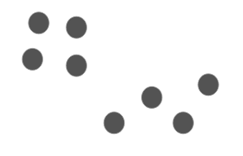
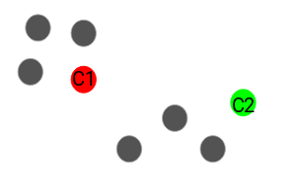
Kmeans Clustering – Steps
Suppose we’ve a couple of data points that need to be segmented.
Step 1: Choose the number of clusters ‘k’
The first step in k-means is to pick the number of clusters, k.
Step 2: Select k random points from the data as centroids
Next, we randomly select the centroid for each cluster. Let’s say we want to have 2 clusters, so k is equal to 2 here. We then randomly select the centroid as shown.
Here, the red and green circles represent the centroid for these clusters.
Notes:
Image Link: https://www.analyticsvidhya.com/blog/2019/08/comprehensive-guide-k-means-clustering/

Slide 15
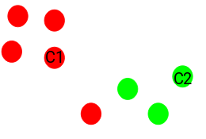
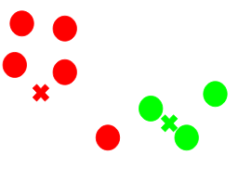
Kmeans Clustering – Steps
Step 3: Assign all the points to the closest cluster centroid
Once we have initialized the centroids, we assign each point to the closest cluster centroid.
Here you can see that the points which are closer to the red point are assigned to the red cluster whereas the points which are closer to the green point are assigned to the green cluster.
Step 4: Recompute the centroids of newly formed clusters
Now, once we have assigned all of the points to either cluster, the next step is to compute the centroids of newly formed clusters. The red and green crosses are the new centroids.
Notes:
Image Link: https://www.analyticsvidhya.com/blog/2019/08/comprehensive-guide-k-means-clustering/

Slide 16
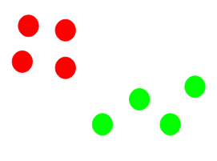
Kmeans Clustering – Steps
Step 5: Repeat steps 3 and 4
The step of computing the centroid and assigning all the points to the cluster based on their distance from the centroid is a single iteration. There may be multiple such iterations depending on the data being dealt with.
There are essentially three stopping criteria that can be adopted to stop the K-means algorithm:
Centroids of newly formed clusters do not change
Points remain in the same cluster
Maximum number of iterations are reached
Notes:
Image Link: https://www.analyticsvidhya.com/blog/2019/08/comprehensive-guide-k-means-clustering/
Notes:
There are essentially three stopping criteria that can be adopted to stop the K-means algorithm:
Centroids of newly formed clusters do not change - We can stop the algorithm if the centroids of newly formed clusters are not changing. Even after multiple iterations, if we are getting the same centroids for all the clusters, we can say that the algorithm is not learning any new pattern and it is a sign to stop the training.
Points remain in the same cluster - Another clear sign that we should stop the training process if the points remain in the same cluster even after training the algorithm for multiple iterations.
Maximum number of iterations are reached -Finally, we can stop the training if the maximum number of iterations is reached. Suppose if we have set the number of iterations as 100, the process will repeat for 100 iterations before stopping.

Slide 17
Silhouette Score
Silhouette refers to a method of interpretation and validation of consistency within clusters of data; a measure of how similar an object is to its own cluster (cohesion) compared to other clusters (separation).
The silhouette ranges from −1 to +1, where a high value indicates that the object is well matched to its own cluster and poorly matched to neighboring clusters. If most objects have a high value, then the clustering configuration is appropriate. If many points have a low or negative value, then the clustering configuration may have too many or too few clusters.
The silhouette can be calculated with any distance metric, such as the Euclidean distance or the Manhattan distance.

Slide 18
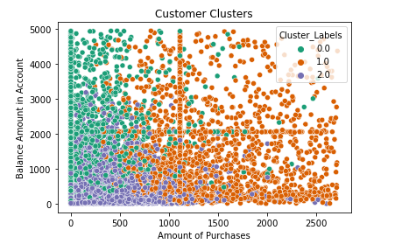
Python Case Study – Customer Segmentation
Interpretation of model:
Clusters are interpreted by performing a groupby() operation on the cluster labels and determining the average for all features as they all are numerical
Measures and suggestions are customised for each customer cluster depending on the area lacking attention from the bank, so that they can adopt those additional steps to increase their business and profit margins

Slide 19
Python Case Study – Customer Segmentation
Post-modelling analysis and business takeaways:
From the customer clusters that have been plotted in terms of ‘PURCHASES’ and ‘BALANCE’, the following inferences can be made:
Cluster ‘0’/Segment ‘1’ – Number of purchase transactions are less even with sufficient credit limit and account balances, along with low installment based purchases. Hence, the bank should offer them some promo-based cashback offers and discounts to further increase the usage of credit cards to encourage further installment based purchases or even oneoff-purchases. This specific cluster of customers prefer cash withdrawal over online purchase transactions. Such cash advances carry a high interest rate and involve immediate accrual of interest as banks view them as high risk, and therefore a keen eye should be kept on this cluster to avoid future defaults. In-depth analysis may yield information regarding their areas of interest while making purchases, which may then be targeted to extend suitable promotional offers and attractive allowances.

Slide 20
Python Case Study – Customer Segmentation
Cluster ‘1’/Segment ‘2’ – The credit limit of this cluster is high and so are their purchase transactions, whether one-off(s) or installments. The bank may target this cluster for credit card up-gradation like Silver to Gold, or Platinum variants with higher credit limits. This group also can be offered premium concierge services on a chargeable basis. They may also be targeted for loan cross-sell as this will help to increase profitability and stickiness. Adequate measures must be taken to convert them to long-term customers.

Slide 21
Python Case Study – Customer Segmentation
Cluster ‘2’/Segment ‘3’ – Purchase transactions and account balances tend to be lesser than their respective averages. Credit limit also appears to be on the low side in comparison to the other two clusters. Hence, adequate measures must be necessitated by the bank to extend more credit and thereby increase their spending to help generate revenue as well as raise the profit margin. Rewards such as cashback or bonus points may help cultivate increased purchases from this segment's side.

Slide 22
Python Case Study – Customer Segmentation
Additional probing into the customer demographics may help banks and/or financial institutions to sensitize the customers to start pension planning immediately, if not already initiated by the latter, and must offer related product solutions as well. The bank should offer insurance plans related to life, health, and general categories.

Slide 23
Thank You!

